Slide 1
APPLIED AGENTIC AI FOR TECHNICAL PROGRAM MANAGERS
MIRA
Multi-Agent PMO Orchestrator
Autonomous project-plan synthesis and live Kanban status reporting for a 15-member, cross-functional AI adoption program.
AUTHOR
RAKESH RANJAN YADAV - AI Technical Program Manager
ORGANIZATION
Nexora Pvt. Ltd. — London, UK
CLIENT PROGRAM
AI Adoption Initiative, ABCDE Ltd.
SUBMISSION
Capstone Project 1 — System Design & Delivery Documentation
August 2026

Slide 2
DOCUMENT ROADMAP
What This Submission Covers
A single narrative — from the operating problem, through system design, to production evidence and measured impact.
01
The Operating Problem
02
The Client Program
Why a TPM juggling 4–6 programs needs an agentic co-pilot
ABCDE Ltd.: team, timeline and risk landscape
03
Two Agentic Use Cases
04
System & Workflow Design
Plan synthesis and live Kanban reporting, with success metrics
The 4-layer architecture and the two n8n pipelines behind it
05
Engineering Under Fire
06
Evidence & Impact
Three real production bugs Mira surfaced — and how they were fixed
Generated artifacts, ROI, and what's next
MIRA — Multi-Agent PMO Orchestrator
2

Slide 3
ORGANIZATIONAL LANDSCAPE
Nexora Pvt. Ltd. & the AI TPM Mandate
MY ROLE — AI TECHNICAL PROGRAM MANAGER
COMPANY PROFILE
1
Cross-functional delivery
Headquarters
Aligning data science, ML engineering, product and dev stakeholders on one delivery cadence.
London, United Kingdom · Est. 2018
Scale
2
Milestone ownership
250+ engineers, data scientists & technologists
Translating high-level business goals into explicit sprint plans and deliverables.
Core offerings
Custom software, cloud infrastructure, AI analytics, cybersecurity
3
Risk & governance
Catching data-pipeline bottlenecks, model drift and SLA constraints early.
Clientele
Fast-growing startups through global enterprises
4
Operational friction
Strategic focus
Running 4–6 concurrent client programs with restricted PM bandwidth — the exact gap Mira was built to close.
Enterprise digital transformation via autonomous automation
MIRA — Multi-Agent PMO Orchestrator
3

Slide 4
PROBLEM STATEMENT
PMO Overhead Is Slowing Every Program Down
Nexora is a startup at heart — most people wear multiple hats. That reality creates four compounding drags on delivery.
2.5 hrs/day
Resource Overload & Multi-Hat Wear
6–8 hrs
Unstandardized Project Planning
High client volume forces TPMs to manage 4–6 programs concurrently, causing operational fatigue.
Documenting plans from unstructured notes (XLSX, PDF, RTF) per client onboarding cycle — with 68% variation in plan completeness.
12+ hrs/wk
Manual Status Reporting
23% higher
Proactive Risk Blindspots
Weekly reporting requires manual extraction from Trello boards into formatted emails, inviting copy-paste errors.
Delayed tracking of blocked Kanban tasks causes missed client SLAs and ballooning delivery overhead.
MIRA — Multi-Agent PMO Orchestrator
4

Slide 5
THE CLIENT ENGAGEMENT
AI Adoption at ABCDE Ltd.
ABCDE Ltd., a mid-sized logistics and supply-chain enterprise, is integrating AI into demand forecasting, route optimization, inventory management and customer support — aiming to cut manual overhead and surface data-driven insight across the business.
PROGRAM SNAPSHOT
15
team members across 12 functions
A cross-functional task force of data scientists, IT professionals and business stakeholders oversees deployment — with Mira acting as the always-on PMO layer underneath them.
8
delivery phases
24
week program duration
15%
Reduction in delivery delays
10
risk categories tracked
10%
Lower operational cost
4
source file formats ingested
MIRA — Multi-Agent PMO Orchestrator
5

Slide 6
THE DELIVERY TEAM
15 Specialists, 5 Functional Pods
The AI Adoption task force spans delivery, engineering, governance and enablement — the exact structure Mira's plan generator has to reason over.
Program Leadership
Data & AI Engineering
Business & Experience
Governance & Quality
Change & Enablement
Priya Sharma
Ravi Mehta
Shalini Rao
Deepak Arora
Ritu Malhotra
Project Manager
AI/ML Lead
Business Analyst
QA/Test Engineer
Change Management Lead
Anjali Desai
Sonia Nair
Meera Kulkarni
Karan Singh
Data Scientist
UX/UI Designer
Legal & Compliance Officer
AI Vendor/Partner Liaison
Mohan Iyer
Shruti Patil
Neeraj Kapoor
Swati Joshi
Data Engineer
Customer Experience Analyst
IT Infrastructure Manager
Training & Enablement Specialist
Akash Verma
Alok Bansal
DevOps Engineer
Logistics Operations Lead
MIRA — Multi-Agent PMO Orchestrator
6

Slide 7
PROGRAM TIMELINE
8 Phases Across 24 Weeks
Wk 1–2
Wk 5–6
Wk 11–14
Wk 17–22
Project Initiation
Use Case Selection
Pilot Implementation
Full Deployment
Charter signed off; team structure finalized
Prioritized use cases with success criteria
Pilot results + performance metrics
Production rollout; training completed
1
3
5
7
2
4
6
8
Wk 3–4
Wk 7–10
Wk 15–16
Wk 23–24
Current State Analysis
Pilot Design
Evaluation & Iteration
Monitoring & Review
Systems audit + gap analysis report
Working prototypes; data pipelines established
Updated models and process refinements
Closure report + scaling recommendations
Mira's Document Intelligence Pipeline ingests this exact timeline (as a source PDF) to seed the generated project plan.
MIRA — Multi-Agent PMO Orchestrator
7

Slide 8
RISK LANDSCAPE
10-Category Risk Register Feeds Mira's Plans
Every generated plan is grounded in this register — so mitigation strategy, not just milestone dates, reaches the stakeholder inbox.
Risk Category
Core Challenge
Mitigation Strategy
Data Quality & Availability
Poor model performance from incomplete/unstructured data
Early data audits + governance
Integration Issues
Legacy-system friction delays deployment
API/middleware roadmap + DevOps support
Talent & Skills Gap
Internal AI/ML expertise shortfall
Staff training + specialized hiring
Change Resistance
Low adoption erodes ROI
Change management + early engagement
Ethical & Legal Concerns
Bias, privacy or compliance exposure
Legal review + fairness checks
+ 5 more categories tracked in the full register: cost overruns, unrealistic expectations, model drift, security vulnerabilities, vendor lock-in.
MIRA — Multi-Agent PMO Orchestrator
8

Slide 9











Predictive Risk & SLA Early-Warning Agent
USE CASE 3
Capstone Use Case Candidate — Continuous Risk Monitoring for the Nexora TPM Portfolio
Pain Point
Business / Technical Impact
TPMs at Nexora run multiple projects simultaneously and lack the bandwidth to continuously assess risk across all of them. Risk registers (e.g., ABCDE Ltd.'s AI Adoption Project) are built once, manually, and rarely revisited — so issues like data-quality gaps, integration delays, or scope creep surface late, after they've already caused schedule slippage.
Business: Missed milestones translate directly into overhead cost — idle resources, re-planning, stakeholder trust erosion, and potential contract penalties.
Technical: Without continuous monitoring, mitigation actions (data audits, retraining cycles) trigger reactively instead of proactively, compounding technical debt.
5 Success Metrics
1
2
3
4
5
Reduction in Missed Milestones
Mean Time-to-Detect a Risk
Projects w/ Auto-Refreshed Risk Register
TPM Hours Saved per Week
Stakeholder Confidence Score
≥ 30% within 2 quarters
< 48 hours
100% updated weekly
≥ 5 hrs / TPM / week
≥ 4 / 5 (quarterly survey)
Potential Knowledge Base
Historical project plans, timelines & closure reports
10-category risk taxonomy (data, integration, talent, ethics, cost, drift, security…)
Live Kanban/PM exports (Trello/Jira), calendars & meeting-note transcripts
Org chart & team roster — flags single points of failure
Prior post-mortems & lessons-learned documents

Slide 10
USE CASE 01
Autonomous Project Plan Synthesis
PAIN POINT
5 SUCCESS METRICS
Ingesting fragmented initiation files across formats (PDF, XLSX, TXT, RTF/DOCX) to draft project plans is highly manual — 6–8 hours per onboarding cycle.
Plan generation time under 60 seconds
1
BUSINESS IMPACT
100% ingestion coverage across PDF / XLSX / TXT / RTF
Accelerates client onboarding by 85% and eliminates PM drafting overhead entirely.
2
3
Milestone extraction accuracy above 95%
KNOWLEDGE BASE
Scope statements, SOWs, architecture specs, resource rosters, risk register templates.
5+ hours of TPM manual time saved per plan
4
5
100% downstream email delivery rate
MIRA — Multi-Agent PMO Orchestrator
9

Slide 11
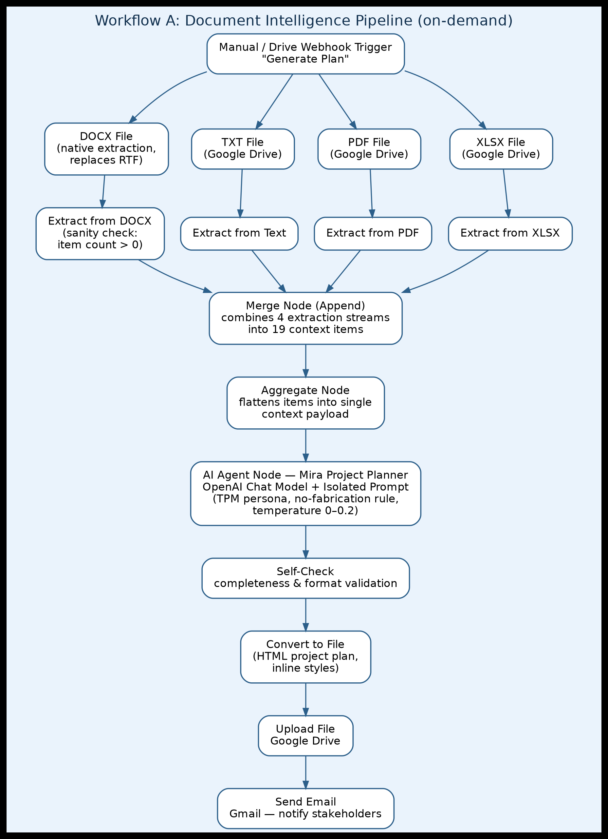
Autonomous Project Plan Flow Chart
USE CASE 01
Step | Node / Component | Function
1 | Manual / Drive Webhook Trigger | Kicks off plan generation on demand or when new onboarding files land in Drive.
2 | Format-Specific Extraction Nodes (XLSX, PDF, TXT, DOCX) | Four parallel nodes convert each binary file into a standardized JSON/text payload; an item-count sanity check catches silent data loss (the root cause of the earlier RTF bug) before it reaches the LLM.
3 | Merge (Append) Node | Combines the four extraction outputs into a single ordered list of ~19 context items.
4 | Aggregate Node | Flattens the merged items into one context payload sized for the agent's context window.
5 | AI Agent — Mira Project Planner | Isolated OpenAI Chat Model node (never shared with Workflow B) reasons over the full context and drafts the structured project plan under a strict output contract.
6 | Self-Check | Code node verifies the plan covers all required phases/milestones and rejects incomplete or fabricated output before it is formatted.
7 | Convert to File | Renders the validated plan as an HTML document with fully inline styles for email-client compatibility.
8 | Upload File (Drive) + Send Email (Gmail) | Persists the plan to Google Drive and delivers it to stakeholders with zero manual PM involvement.
Step-by-Step Breakdown
MIRA — Multi-Agent PMO Orchestrator
10

Slide 12
USE CASE 02
Live Kanban Sync & Executive Briefing
PAIN POINT
5 SUCCESS METRICS
Tracking live Kanban board shifts and compiling weekly reports by hand leads to stale reporting and delayed risk escalation.
Trello REST API sync latency under 3 seconds
1
BUSINESS IMPACT
100% board parity in status report generation
Delivers real-time executive visibility and proactive risk mitigation without a PM in the loop.
2
3
Immediate blocked-card escalation
KNOWLEDGE BASE
Trello board webhooks, workflow lists, owner-assignment logs, SLA thresholds, historical velocity data.
Zero manual PM copy-paste overhead
4
5
Stakeholder on-time delivery above 98%
MIRA — Multi-Agent PMO Orchestrator
10

Slide 13
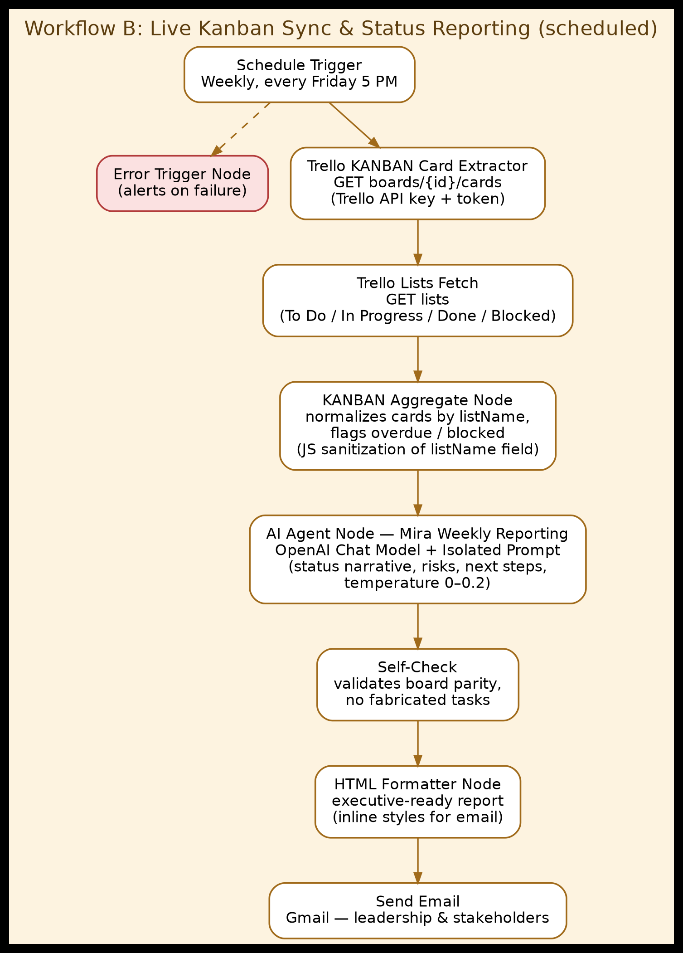
KANBAN Sync Flow Chart
USE CASE 02
Step | Node / Component | Function
1 | Schedule Trigger (+ Error Trigger) | Runs automatically on a weekly cadence with no manual kickoff; the parallel Error Trigger node captures and alerts on any run failure.
2 | Trello KANBAN Card Extractor | GET boards/{id}/cards against the Trello REST API pulls the live state of every card on the board.
3 | Trello Lists Fetch | GET lists retrieves the board's canonical status columns (To Do / In Progress / Done / Blocked) used to bucket cards accurately.
4 | KANBAN Aggregate Node | Normalizes cards by listName, flags overdue/blocked items, and sanitizes the listName field via a JS Code node (fix for the earlier report-inaccuracy bug).
5 | AI Agent — Mira Weekly Reporting | Isolated OpenAI Chat Model node synthesizes board metrics into a plain-English progress, risk, and next-steps narrative.
6 | Self-Check | Validates 100% board parity and confirms no tasks were invented before the report leaves the agent.
7 | HTML Formatter Node | Builds the final executive-ready HTML report with inline styles for consistent rendering across email clients.
8 | Send Email (Gmail) | Delivers the consolidated status report to leadership and client stakeholders on schedule, with zero manual copy-paste.
MIRA — Multi-Agent PMO Orchestrator
10

Slide 14
SYSTEM DESIGN
A Four-Layer Agentic Architecture
One reasoning core, two entry points — documents on one side, live Kanban data on the other.
01
Multi-Source Ingestion
Google Drive API (XLSX, PDF, TXT, RTF) & Trello REST API (live cards, assignees, due dates)
02
Extraction & Normalization
Format-specific extraction nodes (XLSX / PDF / Text) feed a unified merge node
03
Agentic Reasoning Core — Mira
OpenAI LLM chat model with short-term memory and external tool-calling
04
Distribution & Output
Auto text-file conversion, Google Drive upload, and Gmail API delivery
MIRA — Multi-Agent PMO Orchestrator
MIRA — Multi-Agent PMO Orchestrator
11
11

Slide 15
N8N ORCHESTRATION PIPELINE · WORKFLOW 1
Document Intelligence & Plan Ingestion
Four stages, one manual trigger — raw files in, an executive-ready plan out.
STEP 1
STEP 2
STEP 3
STEP 4
Trigger & Drive Extraction
Format-Specific Parsing
Context Aggregation
Agent Reasoning & Delivery
Manual execution or Drive webhook fetches four raw project-context files (XLSX, PDF, TXT, RTF) from Google Drive.
Individual n8n extraction nodes process each binary stream into standardized JSON string payloads.
A Merge (Append) node combines 19 items into a single context payload, followed by an Aggregator node.
The Mira LLM Agent processes the full context, generates a project plan, converts it to a file, uploads it to Drive, and emails stakeholders.
MIRA — Multi-Agent PMO Orchestrator
12

Slide 16
N8N ORCHESTRATION PIPELINE · WORKFLOW 2
Live Trello Sync & Status Reporting
Five phases, zero human kickoff — the board's current state becomes an executive briefing every week.
STEP 1
STEP 2
STEP 3
STEP 4
STEP 5
Schedule Trigger
Trello Card Extractor
KANBAN Aggregator
Mira Reporting Agent
Automated Delivery
A weekly recurring trigger runs automatically, with no human intervention.
A GET request to the Trello boards/cards endpoint pulls the live task-board state.
Normalizes raw Trello card objects into structured status categories: Done, Doing, To Do, Blocked.
The OpenAI chat model synthesizes board metrics into a clean, executive-ready HTML email report.
A Gmail node transmits the formatted status report directly to leadership and client stakeholders.
MIRA — Multi-Agent PMO Orchestrator
13

Slide 17
ENGINEERING UNDER FIRE
From Prototype to Production
Production testing surfaced three real failure modes invisible in prompt-only testing. Each fix changed how the pipeline is built, not just its prompt.
ISSUE 1
ISSUE 2
ISSUE 3
Silent Data Loss
Prompt Interference
Report Inaccuracy
ROOT CAUSE
ROOT CAUSE
ROOT CAUSE
RTF parsing silently dropped 4 of 10 risk-register rows before the data ever reached the AI agent — a plausible but incomplete plan, with no error thrown.
Both triggers — manual plan generation and the scheduled Trello report — fed a single shared AI Agent node, so one capability's instructions bled into the other.
Five distinct failure modes in the weekly report: cards bucketed by title text instead of list membership, cards silently dropped, a fabricated 'Blocked' row, due-date mismatches, and wrong totals.
THE FIX
THE FIX
THE FIX
Switched to native DOCX extraction and added a sanity-check node that flags any item-count mismatch at the extraction boundary.
Split into two dedicated AI Agent nodes, each with an isolated system prompt scoped to exactly one capability.
Rebuilt the Aggregate node to pass a clean listName field, then enforced strict list-to-bucket mapping, a no-fabrication rule, and a self-check reconciliation step in the agent prompt.
MIRA — Multi-Agent PMO Orchestrator
14

Slide 18
OUTPUT ANALYSIS
What Mira Actually Produces
GENERATED ARTIFACT — AI ADOPTION PROJECT PLAN
GENERATED ARTIFACT — WEEKLY KANBAN STATUS REPORT
Phase 1
Discovery & Scope Definition
8
5
1
Phase 2
Data Pipeline & Model Prep
Completed
In Progress
Blocked
Phase 3
Model Design & Development
ACTIVE IN PROGRESS
• Data Collection & Preparation — Ravi Mehta · Due Sep 30
Phase 4
Evaluation & Enterprise Scaling
• Model Design & Development — Ravi Mehta · Due Oct 9
19
context blocks parsed across 4 formats
AUTOMATED RECOMMENDATION ENGINE
Recommends immediate focus on resolving the current blocker, noting it hinders downstream model evaluation while all other tasks remain within scheduled timeline buffers.
<45 sec
full plan synthesized and converted
Zero
missing scope items or unassigned deliverables
MIRA — Multi-Agent PMO Orchestrator
15

Slide 19
STRATEGIC VALUE REALIZATION
Measured PMO Return on Investment
85%
100%
0%
12 hrs
Time Saved in Planning
Automated Reporting
Human Copy-Paste Error
Weekly Bandwidth Recovered
Project-plan synthesis reduced from 6 hours to under 45 seconds.
Eliminated weekly manual Trello data compilation and email drafting.
Direct API integration guarantees full board-data fidelity.
Frees TPMs to focus on client strategy and cross-functional alignment.
MIRA — Multi-Agent PMO Orchestrator
16

Slide 20
SCALE & EXPANSION
Where Mira Goes Next
The architecture is deliberately extensible — each phase below reuses the same ingestion and reasoning core.
1
Bi-Directional Slack & Teams Alerts
2
Predictive Risk & SLA Scoring
Extend the n8n workflow to trigger real-time alerts when a card moves to 'Blocked'.
Feed historical card-velocity metrics into the LLM prompt to predict deadline slippage before cards block.
3
Multi-Board Enterprise Aggregation
4
Calendar Integration
Scale the Trello extractor to fetch data across all client boards for portfolio-level dashboarding.
Connect Mira's status output to automatically reserve review meetings when critical blockers are detected.
MIRA — Multi-Agent PMO Orchestrator
17

Slide 21
THE TAKEAWAY
Mira turns a TPM's busiest week — chasing files and copy-pasting Kanban cards — into 45 seconds of synthesis and one clean email.
Built and hardened in production on n8n with OpenAI, Google Drive, Trello and Gmail — for the AI Adoption program at ABCDE Ltd.
AI Technical Program Manager · Nexora Pvt. Ltd. · Capstone Project 1 — Applied Agentic AI for TPMs
Thank you.

Slide 22
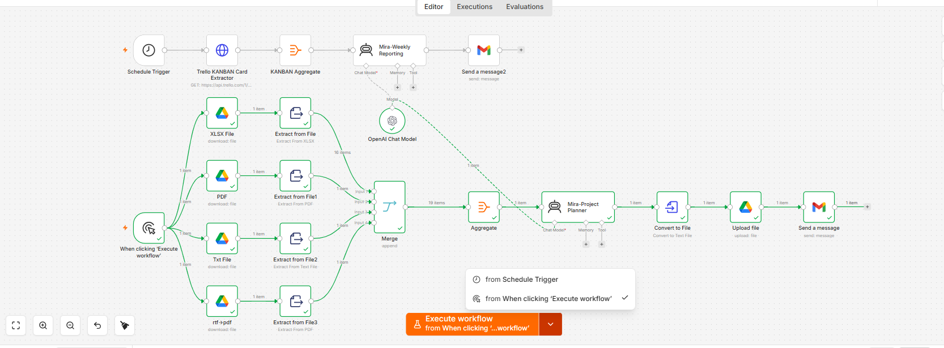
MIRA- n8n Automation Workflow

Slide 23
MIRA-Applied Agentic AI for TPMs- GitHub Repository
https://github.com/rakeshbit/MIRA-Applied-Agentic-AI-for-TPMs/upload/main

Slide 24
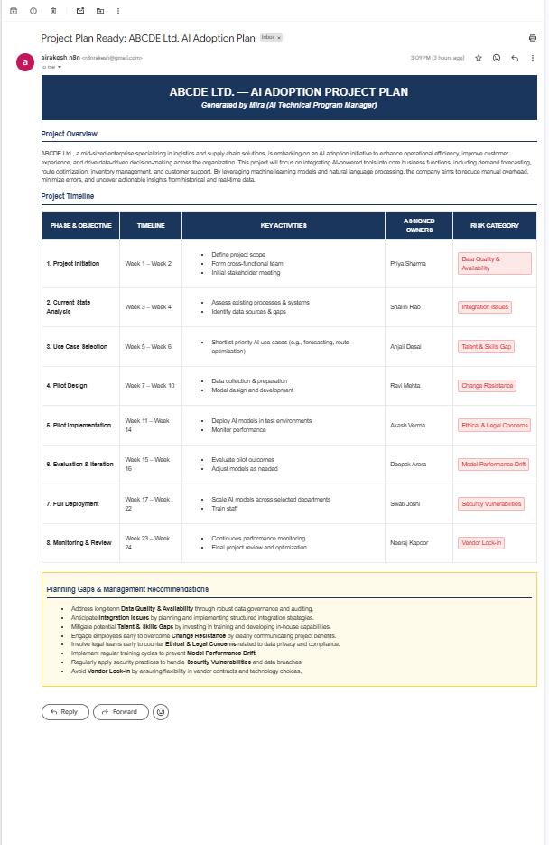
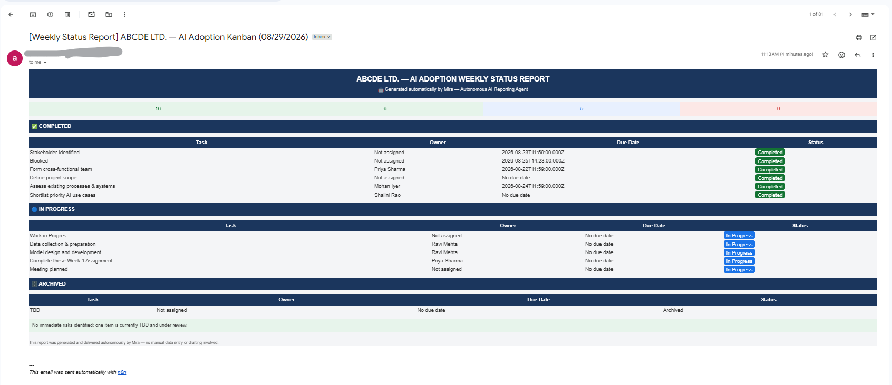
MIRA- n8n Automation Workflow - Outputs

Slide 25
MIRA- n8n Automation Workflow – JSON Outputs

